Slide 1
Prelude:
Walk into My Circle…
(sean forbes)
http://www.deafandloud.com/#!videos/cee5

Slide 2
Captioning, Rhetorically
Brenda Jo Brueggemann
brendabrueggemann@gmail.com

Slide 3
Why I Mind….
https://www.youtube.com/watch?v=RoNR6EWT7D4

Slide 4
Communication (hyphen) Captioning
All the forms of communication
So, what about the captioning?

Slide 5
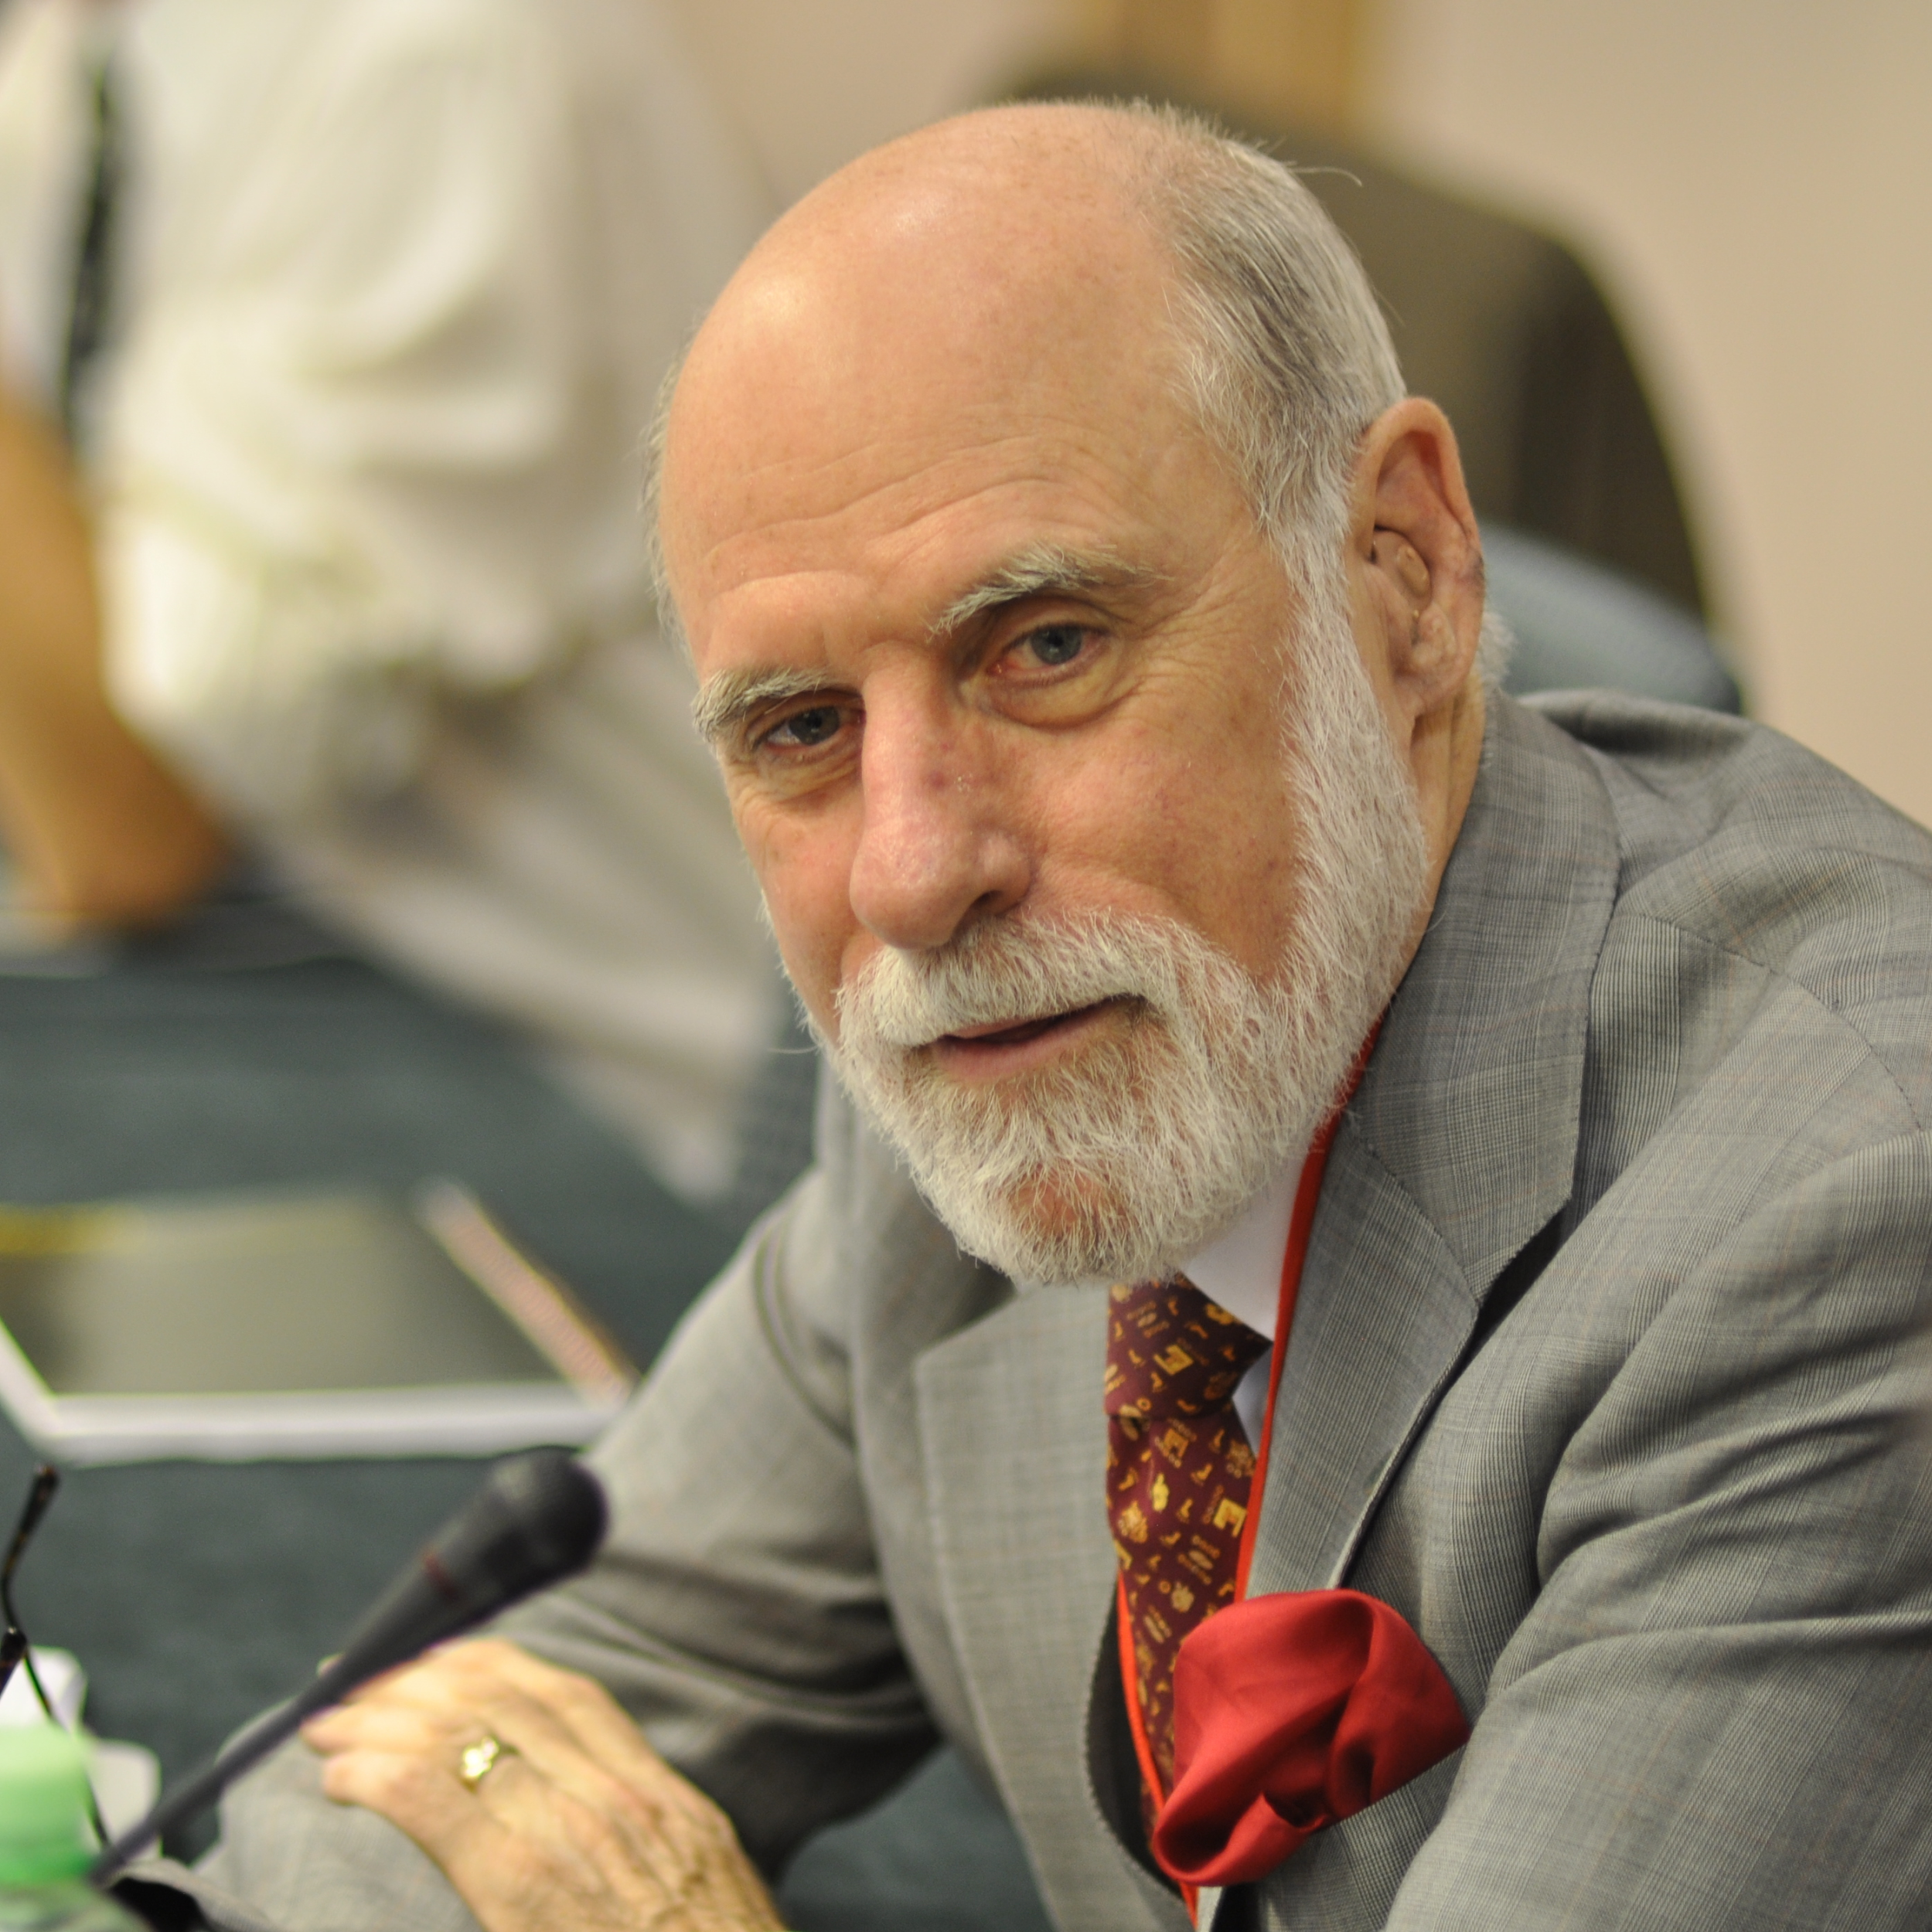
The Backchannel… inventing the Internet
http://research.google.com/pubs/author32412.html

Slide 6
The Backchannel… chatrooms/interaction networks (ENFI)
http://kairos.technorhetoric.net/1.2/coverweb/cmcmday.html
C. 1995: Abstract: This chapter demonstrates how a particular application of CMC, Electronic Networks For Interaction (ENFI) is being used to change the social dynamic of the writing classroom. ENFI is not software but a concept; the concept is essentially that writing is taught in a computer lab with a network supporting real-time CMC. Because it allows teachers and students to explore, collaborate, and expand on ideas in class in writing, and allows them to see each other in the process of developing ideas, writing for each other and not just to "the teacher," ENFI supplements and expands on the activities teachers can use to help students meaningfully participate in a discourse community and improve their writing.

Slide 7
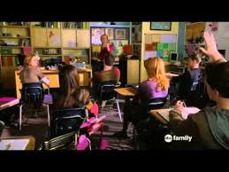
Deaf Gain (brought to you by Marlee Matlin and “Switched at Birth”)
https://www.youtube.com/watch?v=F5W604uSkrk

Slide 8
So, what do we (ALL) gain from captioning??

Slide 9
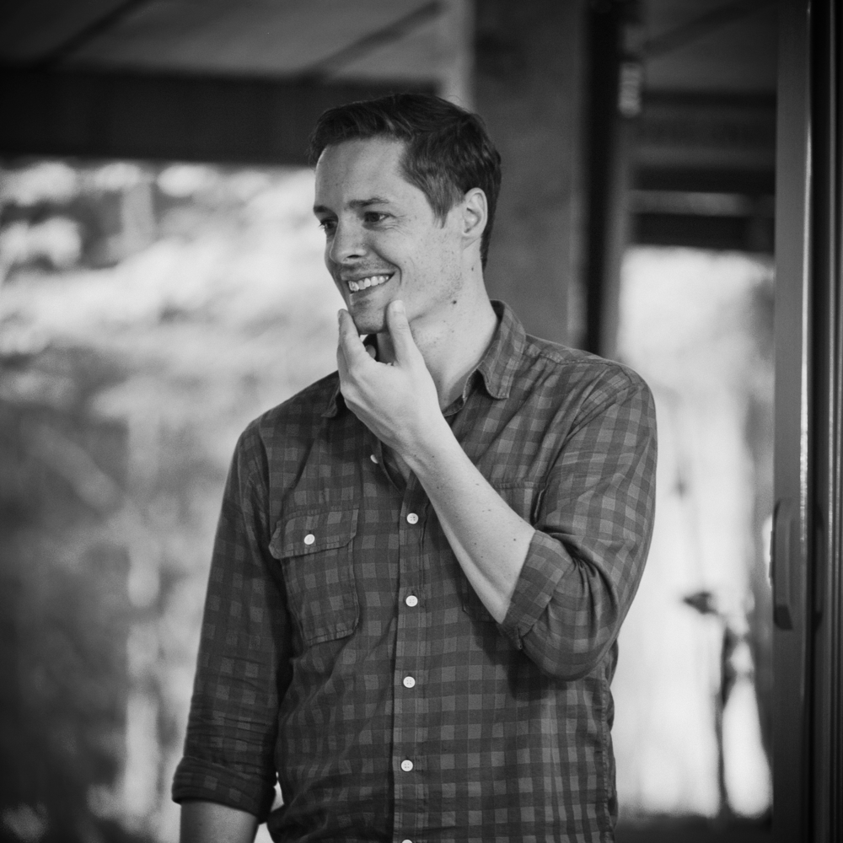
Unique approaches to captioning
Wayne Betts, (deaf) filmmaker
https://www.youtube.com/watch?v=ocbyS9-3jjM

Slide 10
Unique approaches to captioning
Sean Forbes, (deaf) musician
http://www.deafandloud.com/

Slide 11
Do-do? So, what will you (captioning) do?
How to think about/make captions for your C60 video?
How to teach/encourage captions in your writing program and classrooms?

